Slide 1
Web Technologies
Laravel Framework

Slide 2
Summary of Today’s Lecture
Laravel Framework
Introduction
Features
Laravel vs Core PHP
Laravel Model-View-Controller (MVC) Framework
Setting Up Laravel Development Environment
Installing Composer
Installing Laravel
Creating Laravel Project
Laravel Directory Structure
Routes
View
Controllers

Slide 3
Laravel Introduction
Laravel is a free, open-source PHP web framework, created by Taylor Otwell and intended for the development of web applications following the model–view-controller (MVC) architectural pattern and based on Symfony.
Some of the features of Laravel are a modular packaging system with a dedicated dependency manager, different ways for accessing relational databases, utilities that aid in application deployment and maintenance, and its orientation toward syntactic sugar.
The source code of Laravel is hosted on GitHub and licensed under the terms of MIT License.
Laravel's first beta release was made available on June 9, 2011, followed by the Laravel 1 release later in the same month. Laravel 1 included built-in support for authentication, models, sessions, views, routing and other mechanisms, but lacked support for controllers that prevented it from being a true MVC framework.
The latest Laravel version is version 9, which was released on February 8, 2022.

Slide 4
Laravel Features
The following are some key features of the Laravel Framework:
Bundles provide a modular packaging system since the release of Laravel 3, with bundled features already available for easy addition to applications. Furthermore, Laravel 4 uses Composer as a dependency manager to add framework-agnostic and Laravel-specific PHP packages available from the Packagist repository.
Eloquent ORM (object-relational mapping) is an advanced PHP implementation of the active record pattern, providing at the same time internal methods for enforcing constraints on the relationships between database objects. Following the active record pattern, Eloquent ORM presents database tables as classes, with their object instances tied to single table rows.
Query builder, available since Laravel 3, provides a more direct database access alternative to the Eloquent ORM. Instead of requiring SQL queries to be written directly, Laravel's query builder provides a set of classes and methods capable of building queries programmatically. It also allows selectable caching of the results of executed queries.

Slide 5
Laravel Features
Application logic is an integral part of developed applications, implemented either by using controllers or as part of the route declarations. The syntax used to define application logic is similar to the one used by Sinatra framework.
Blade templating engine combines one or more templates with a data model to produce resulting views, doing that by transpiling the templates into cached PHP code for improved performance. Blade also provides a set of its own control structures such as conditional statements and loops, which are internally mapped to their PHP counterparts. Furthermore, Laravel services may be called from Blade templates, and the templating engine itself can be extended with custom directives.

Slide 6
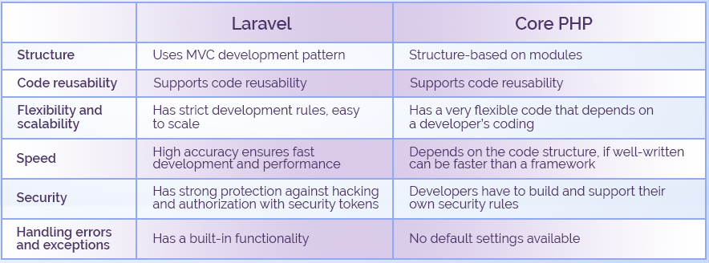
Laravel vs Core PHP

Slide 7
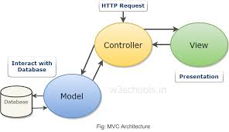
Laravel – Model-View-Controller(MVC) Framework
Model–view–controller (usually known as MVC) is a software design pattern commonly used for developing user interfaces that divides the related program logic into three interconnected elements. In MVC, we have three primary concepts.
Model
Represents an individual database table (or record from the table) – think “company” or “dog”
View
Represents the template the output your data to the end user – think “the login page template with this given set of HTML and CSS and JavaScript”.
Controller
Like a traffic cop, take HTTP requests from the browser, gets the right data out of the database and other storage mechanisms, validates user input, and eventually sends a response back to the user.

Slide 8
Setting Up Laravel Environment (Step-1) Installing Composer
If your already have a WAMP or XAMPP installed on your computer, they will be likely be fine to run Laravel, assuming you have the right version of PHP.
The first step is to install a Composer. Composer is a dependency manager for PHP, much like NPM for Node or Ruby Gems for Ruby. You will need Composer to install Laravel, update Laravel, and bring in external dependencies.
Download the latest version of Compose installable archive file from
https://getcomposer.org/download/
Download and run Composer-Setup.exe - it will install the latest composer version whenever it is executed.
The installer - which requires that you have PHP already installed - will download Composer for you and set up your PATH environment variable so you can simply call composer from any directory.

Slide 9
Setting Up Laravel Environment (Step-2) Install Laravel Installer/ Create new Project
Next step is to install Laravel. To install the Laravel as a global Composer dependency, type the following command in the command prompt:
Composer global require Laravel/installer
Once you have the Laravel installer tool installed, spinning up a new Laravel project is simple.
Just run the command laravel new <ProjectName> from your command line.
This will create a new subdirectory of your current directory named <ProjectName> and install a bare Laravel project in it.

Slide 10
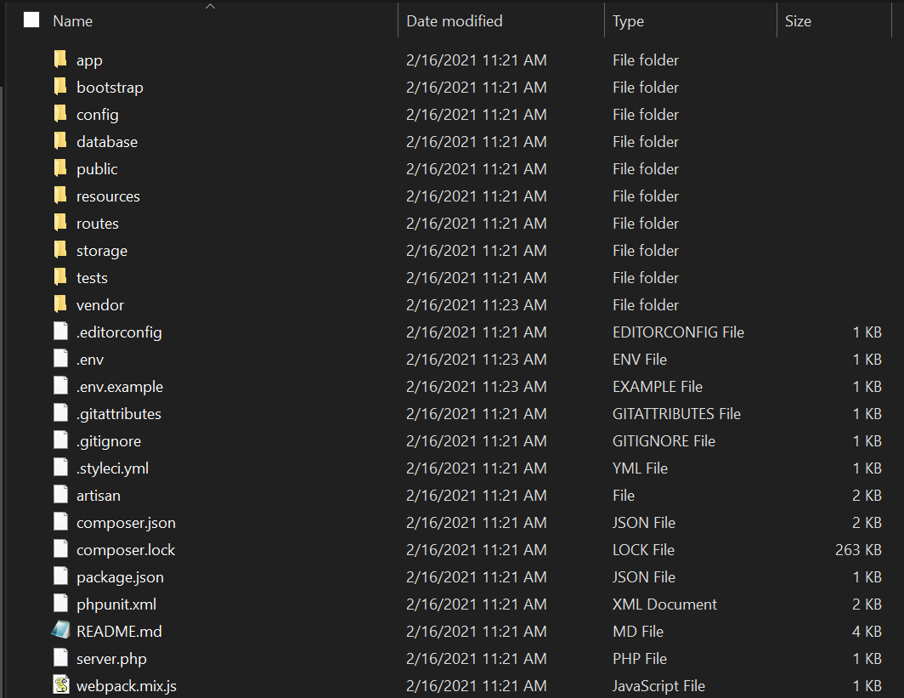
Laravel Directory Structure
When you open up the directory that contains a skeleton Laravel application, you will see the following files and directories

Slide 11
The folders Description
The root directory contains the following folders by default.
app
Where the bulk of your actual application will go. Models, controllers, commands, and your PHP domain code all go in here.
bootstrap
Contains the files that the Laravel framework uses to boot every time it runs.
config
Where all the configuration files live.
database
Where database migrations, seeds and factories live.
public
The public directory contains the index.php file, which is the entry point for all requests entering your application and configures autoloading. This directory also houses your assets such as images, JavaScript, and CSS.

Slide 12
The folders description.
resources
Where files that are needed for other scripts live. Views, languages files, and optionally (Sass/ Less/ source CSS) and other JS files live here.
routes
Where all of the route definitions live, both for HTTP routes and console routes or artisan commands.
storage
Where caches, logs and compiled system files live.
tests
Where unit and integration tests live.
vendor
Where Composer installs its dependencies. Composer is expected to load these dependencies as part of your deploy process on any remote servers.

Slide 13
The files description
The root directory also contains the following files.
.editorconfig
Gives your IDE/ text editor instructions about Laravel’s coding standards (for example, size of indents, whether to trim trailing whitespace etc).
.env and .env.example
Dictate the environment variables (variables that are expected to be different in each environment and are therefore not committed to version control). .env.example is a template that each environment should duplicate to create its own . env file.
.gitignore and .gitattributes
Git configuration files
artisan
Allows you to run artisan commands from the command line.
composer.json and composer.lock
Configuration files for composer; composer.json is user-editable and composer.lock is not. These files share some basic information about the project and also define its PHP dependencies.

Slide 14
The files description
package.json
Like composer.json but for frontend assets and dependencies of the build system; it instructs NPM on which JavaScript-based dependencies to pull in.
phpunit.xml
A configuration file for PHPUnit, the tool Laravel uses for testing out of the box.
readme.md
A markdown file for giving a basic introduction to Laravel.
server.php
A backup server that tries to allow less-capable servers to still preview the Laravel application
webpack.mix.js
The (optional) configuration file for Mix. If you are using Elixir, you will instead see gulpfile.js These files are for giving your build system directions on how to compile and process your frontend assets.

Slide 15
Routes
Routing is the process of mapping Laravel page with a specific URL.
The essential function of any web application framework is taking requests from a user and delivering responses, usually via HTTP.
This means defining an application’s routes is the first and most important concept to approach when learning a web framework; without routes, you have no ability to interact with the end user.
In Laravel application, web routes are defined in routes/web.php.
The simplest way to define a route is to match a path (for example, /) with a closure, as described in following example,
use Illuminate\Support\Facades\Route;
Route::get('/', function () {
return 'Hello World';
});
We have now defined that, if anyone visits / (the root of your domain), Laravel’s router should run the Closure defined there and return the result. Note that we return our content and don’t echo or print it.

Slide 16
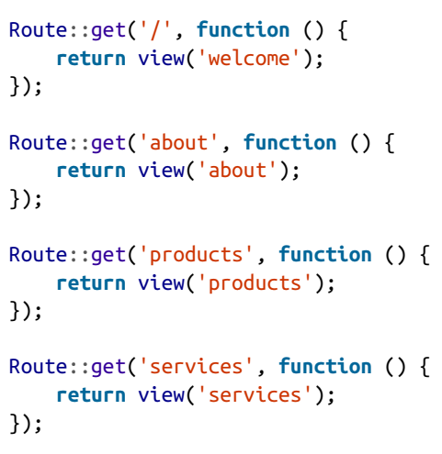
Route Definition Example
Many simple web sites could be defined entirely within the Routes file. Simple GET routes combined with a few templates can serve a classic web site easily

Slide 17
Views
Views (or Templates) are files that describe how some particular output should look like. You might have views for JSON or XML or emails, but the most common views in a web framework output HTML.
In Laravel, there are two formats of view you can use out of the box: Blade or PHP. The difference is in the filename: about.php will be rendered with the PHP engine, and about.blade.php will be rendered with the Blade engine.
Views separate your controller / application logic from your presentation logic and are stored in the resources/views directory. A simple view might look something like this:
<!-- View stored in resources/views/greeting.blade.php -->
<html>
<body>
<h1>Hello, {{ $name }}</h1>
</body>
</html>
Since this view is stored at resources/views/greeting.blade.php, we may return it using the global view helper like so:
Route::get('/', function () {
return view('greeting', ['name' => 'James']);
});

Slide 18
Route Handling
Passing a closure to the route definition is not the only way to teach it how to resolve a route.
Closure are quick and simple, but the large your application gets, the clumsier it becomes to put all of your routing logic in one file.
The other common option is to pass a controller name and method as a string in place of the closure.
The controller that you have created can be invoked from within the routes.web.php file using this syntax below:
Route::get('base URI','controller@method’);
For Example, the following statement is telling Laravel, if anyone visits / (the root of your domain), it should pass the request to the index() method of the app/Http/Controllers/WelcomeController controller. This method will be passed the same parameters and treated in the same way as a closure you might have alternatively put in its place.

Slide 19
Controller
In the MVC framework, the letter ‘C’ stands for Controller. It acts as a directing traffic between Views and Models.
Instead of defining all of your request handling logic as closures in your route files, you may wish to organize this behavior using "controller" classes.
Controllers can group related request handling logic into a single class. For example, a UserController class might handle all incoming requests related to users, including showing, creating, updating, and deleting users. By default, controllers are stored in the app/Http/Controllers directory.
Open the command prompt or terminal based on the operating system you are using and type the following command to create controller using the Artisan CLI (Command Line Interface).
php artisan make:controller <ControllerName>
Replace the <controller-name> with the name of your controller. The created constructor can be seen at app/Http/Controllers.

Slide 20
Creating a Controller
If we type the following command to create controller using the Artisan CLI (Command Line Interface).
php artisan make:controller AdminController
It will create a controller file with the name AdminController at app/Http/Controller/StudentController.php.
A basic controller code-snippet will look something like this,
<?php
namespace App\Http\Controllers;
use Illuminate\Http\Request;
class AdminController extends Controller
{
//
}

Slide 21
Summary of Today’s Lecture
Laravel Framework
Introduction
History
Features
Laravel vs Core PHP
Laravel Model-View-Controller (MVC) Framework
Setting Up Laravel Development Environment
Installing Composer
Installing Laravel
Creating Laravel Project
Laravel Directory Structure
Routes
View
Controllers

Slide 22
Resources
Ch-1, Ch-2, Ch-3; Laravel Up and Running, A Framework for Building Modern PHP Apps, 2nd Edition, Matt. Stauffer, Oreilly.

